Slide 1

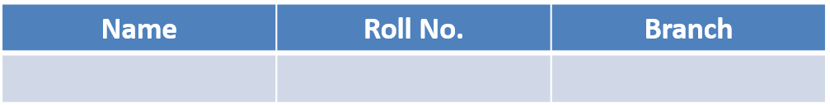
Local Community Portal Design a website for a local community that includes news, events, business directories, and a forum for residents.
Samyak Chaturvedi
202501100600220
Information Technology

Slide 2
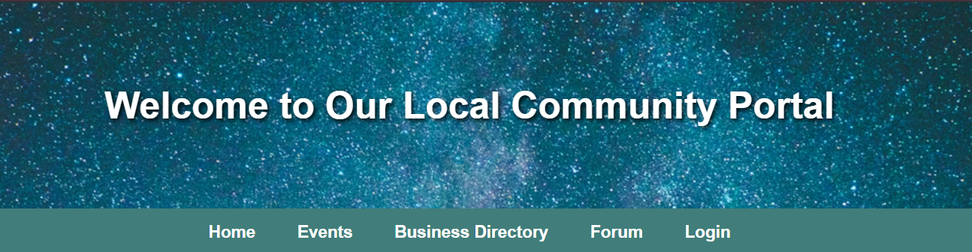
Local Community Portal
Website Use Case Project

Slide 3
Empathize
The first step was understanding the needs of local residents who want quick and organized access to community information.
Users face common problems such as:
Difficulty finding event updates
No central platform for news or announcements
Lack of accessible information on local businesses
No open space for discussions or feedback
Based on this, the website aims to support clarity, simple navigation, and community participation.

Slide 4
Define
The problem identified: Residents lack a unified digital platform for all local information.
Key requirements defined:
Provide news and event updates
Give access to business directory
Allow users to share thoughts via a simple forum
Maintain consistent layout and easy navigation

Slide 5
Ideate
Brainstormed multiple webpage layouts and selected a clean, card-based design.
Decided on a modern teal & beige theme for readability.
Included images and JS form validation for a more advanced, polished look.
Final structure chosen:
Home | Events | Business Directory | Forum | Login

Slide 6
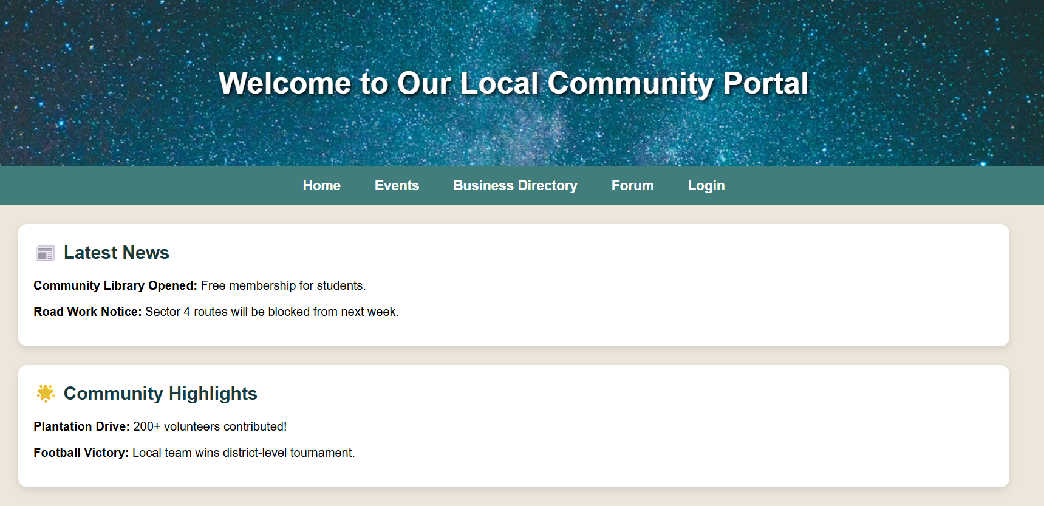
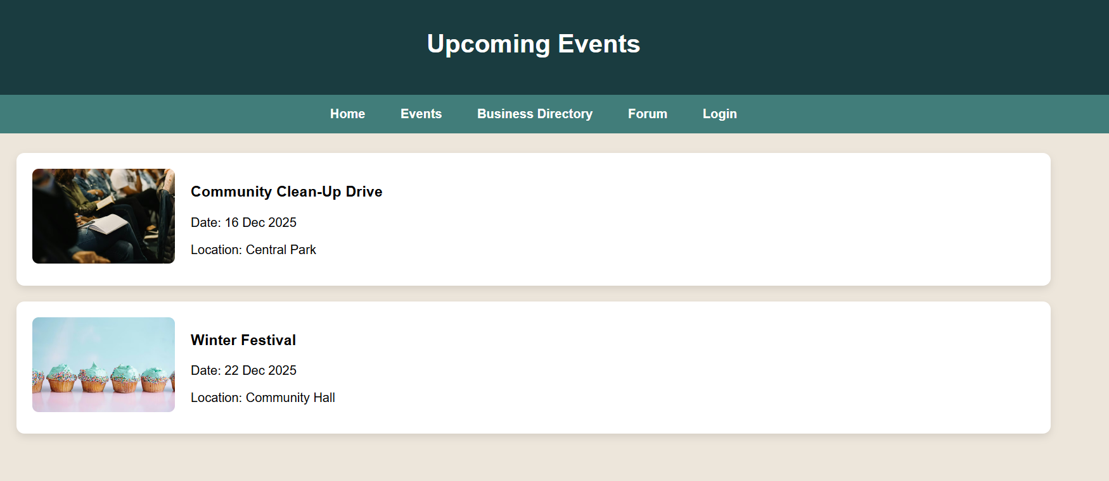
Home Page
Event Page

Slide 7
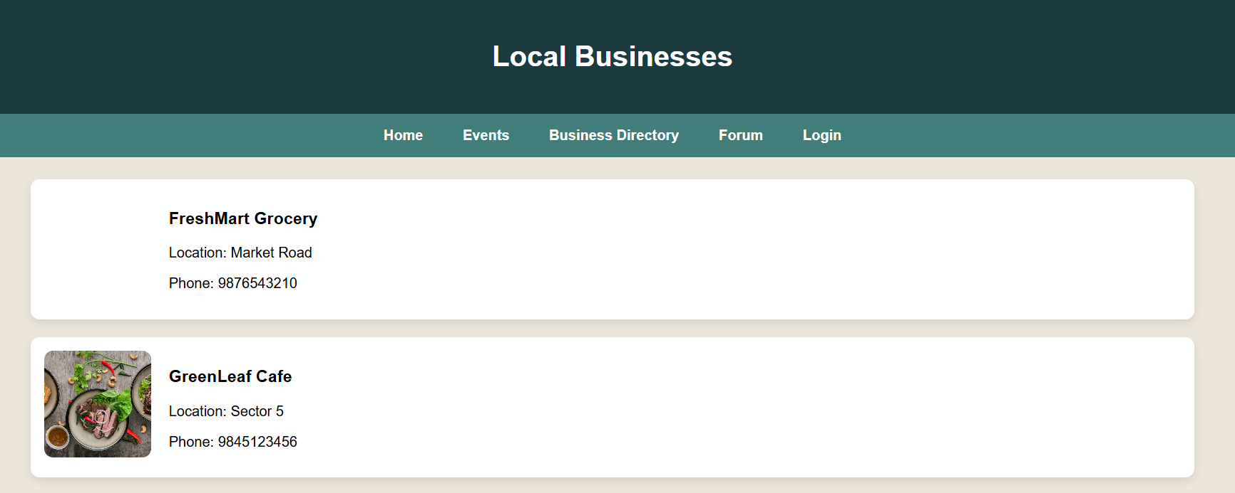
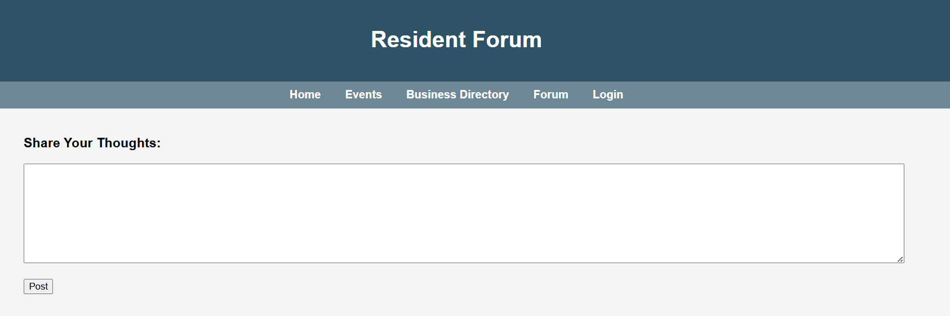
Business Page
Forum Page

Slide 8
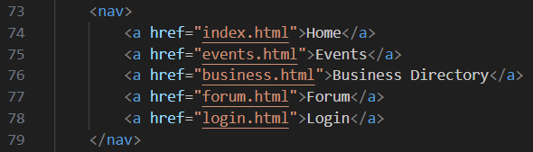
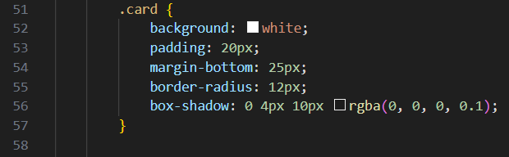
HTML Structure
Internal CSS Design

Slide 9
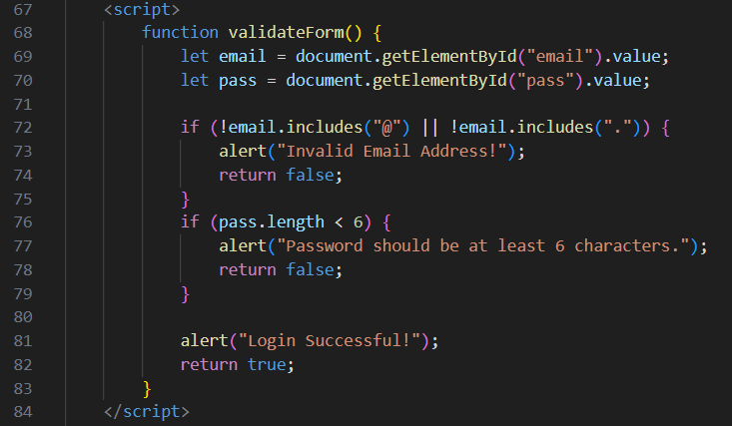
JavaScript
Validation
Form

Slide 10
Additional Features Implemented
Hero Image Header for a modern, clean look
Teal & Beige Color Theme for consistency
Card-Based Layouts for news, events, and businesses
Images from Unsplash for better aesthetics
Forum with JavaScript DOM Updates
Fully responsive spacing and clean typography

Slide 11
Thank you
The end

